Slide 1


Slide 2
Machine Learning using Python for beginners

Slide 3

Basic of Python

Slide 4
Features of Python
Simple and easy to understand
Free and open-source
Portable
High-level language

Slide 5
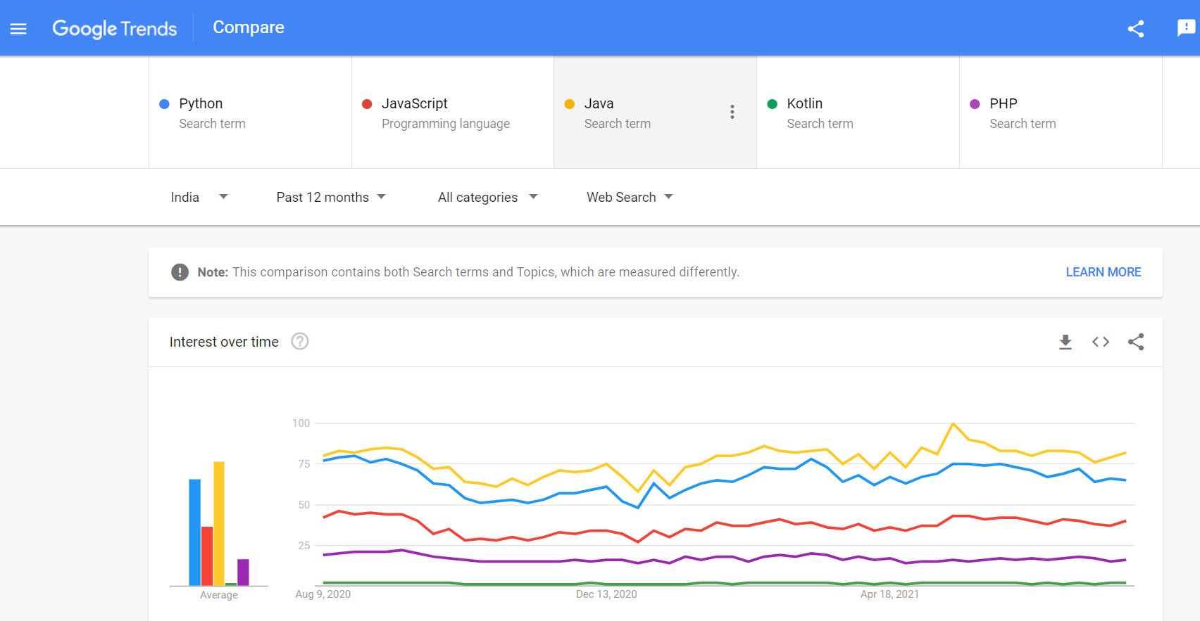

Slide 6
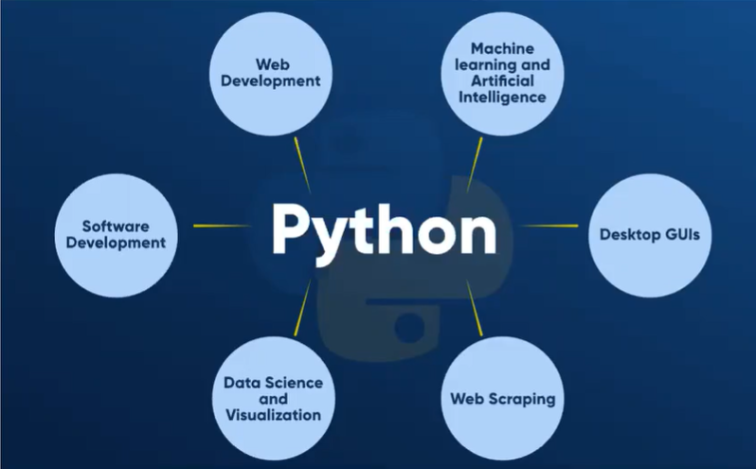
Applications of python

Slide 7
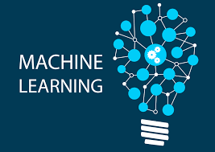

Slide 8
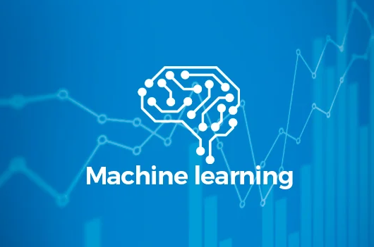
What is MACHINE LEARNING???
Machine learning is a method of data analysis that automates analytical model building. It is a branch of artificial intelligence based on the idea that systems can learn from data, identify patterns and make decisions with minimal human intervention.There are 4 types of Machine Learning algorithms: Supervised,Unsupervised,Semi-Supervised and reinforcement.

Slide 9
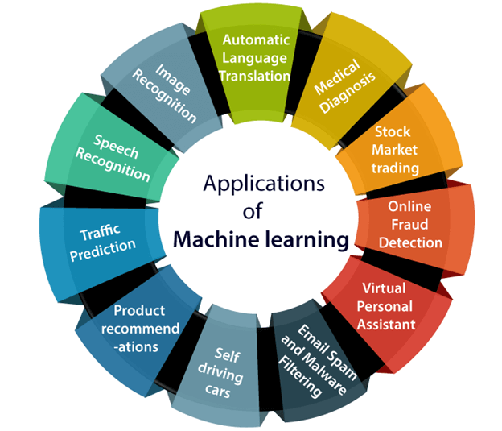

Slide 10
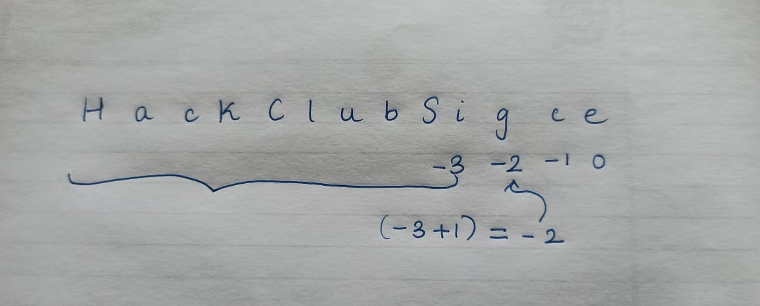

Slide 11
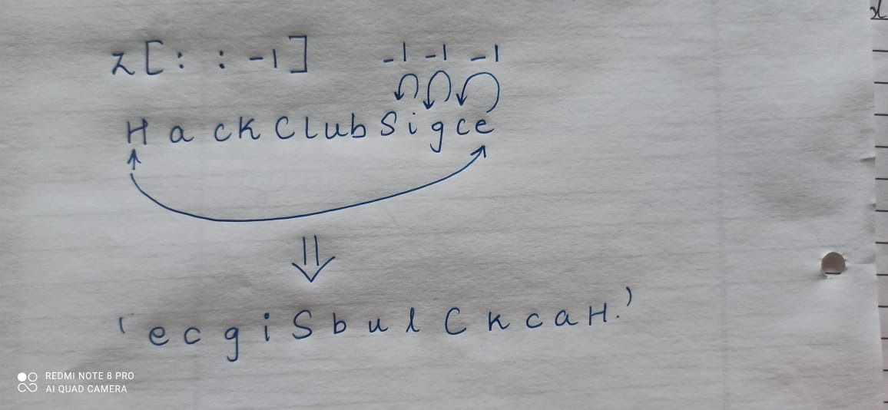

Slide 12
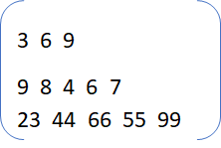

Slide 13
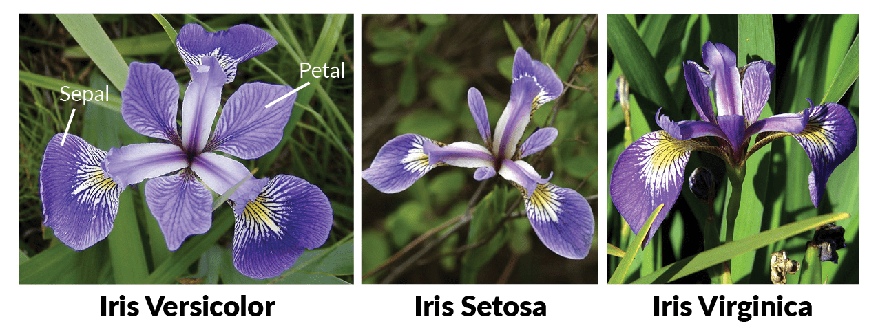
Iris Flower

Slide 14
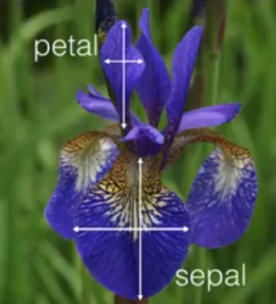

Slide 15
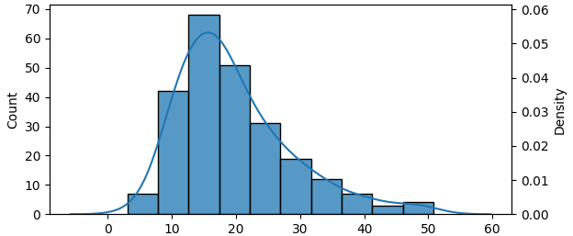
Probability Density Function

Slide 16
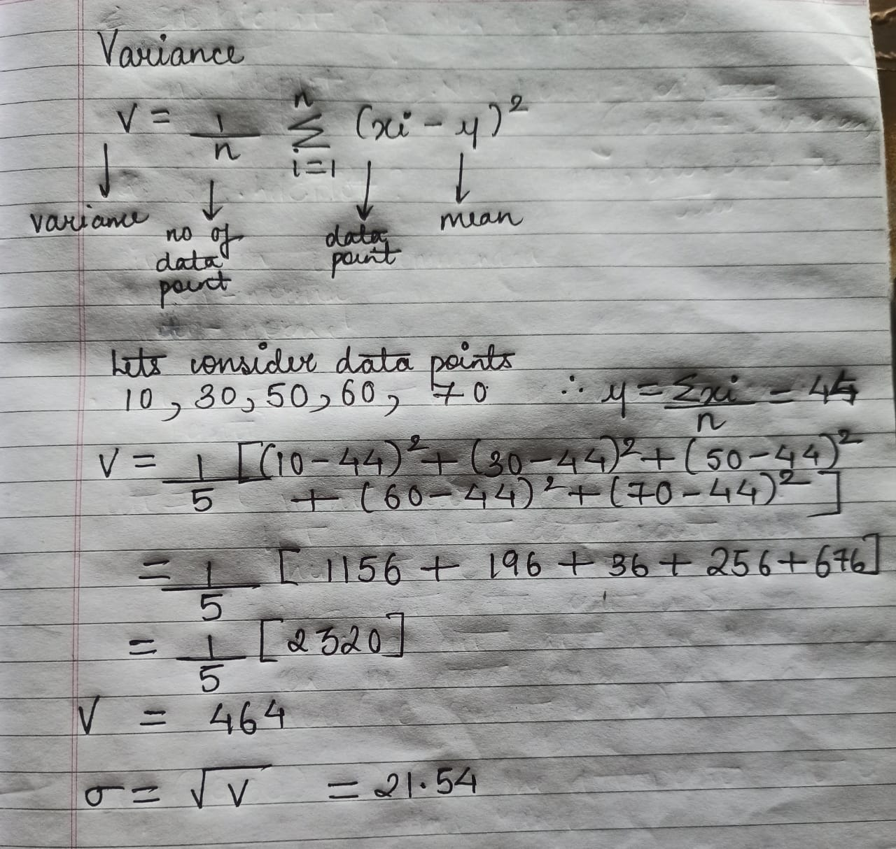

Slide 17
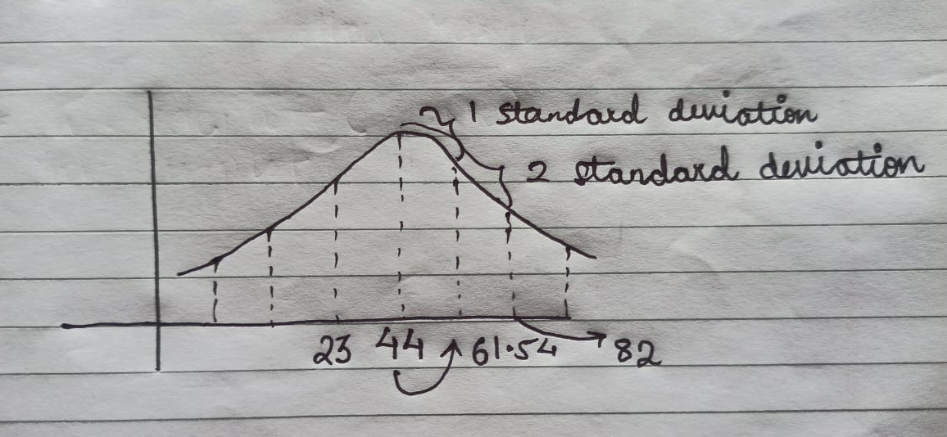

Slide 18
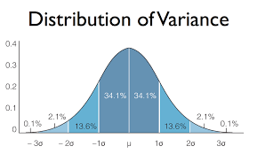

Slide 19
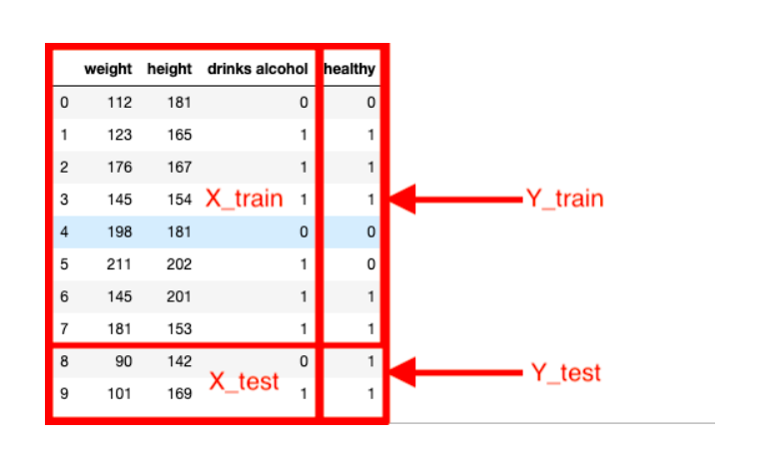

Slide 20
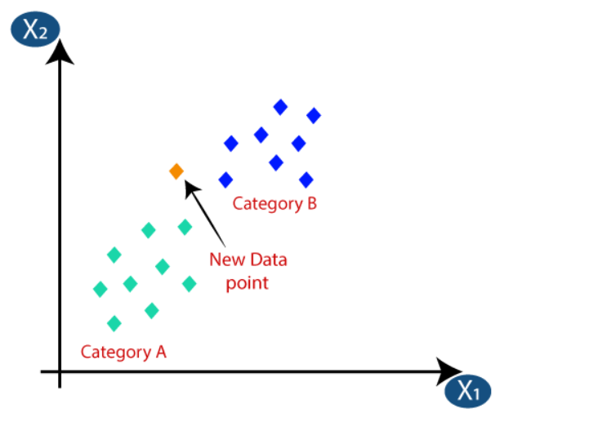
KNN Classification

Slide 21
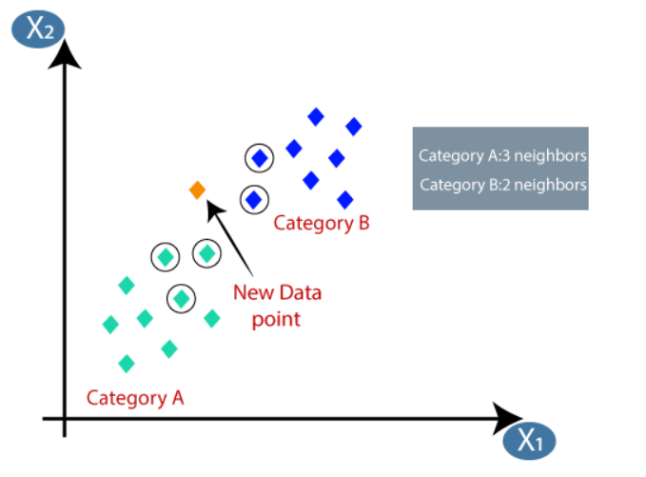
If the value of k is 5

Slide 22
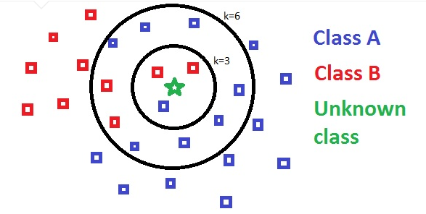

Slide 23
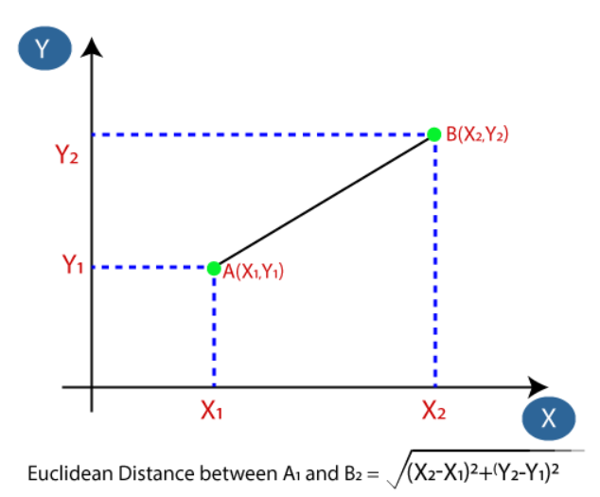
Euclidean Distance

Slide 24
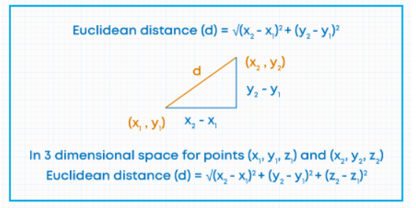
Euclidean Distance

Slide 25
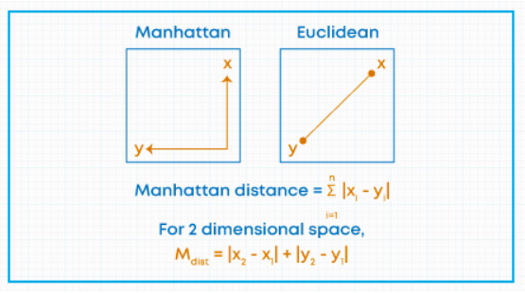
Manhattan Distance

Slide 26
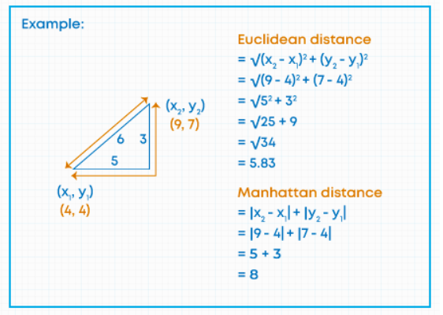
Lets calculate both by taking example

Slide 27
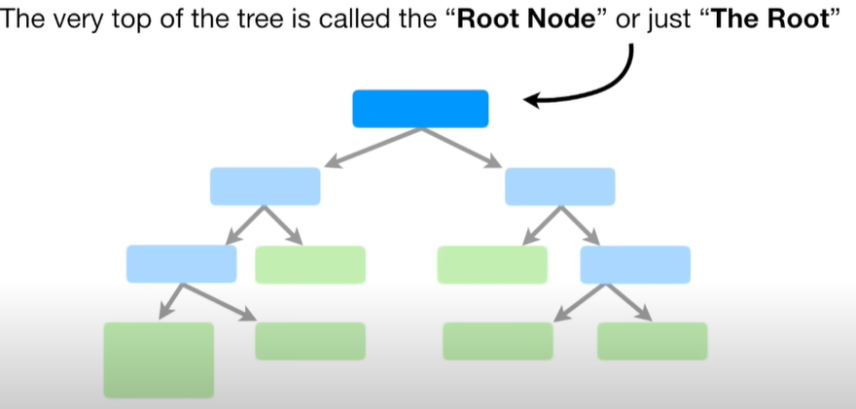
Decision Tree Classifier

Slide 28
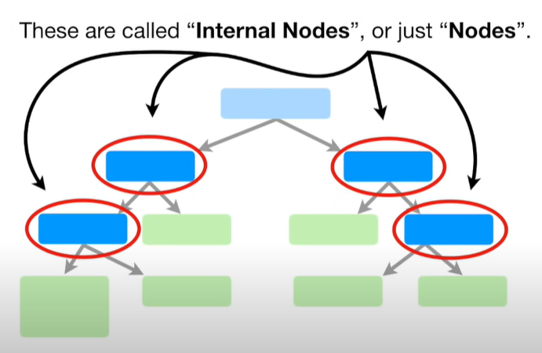

Slide 29
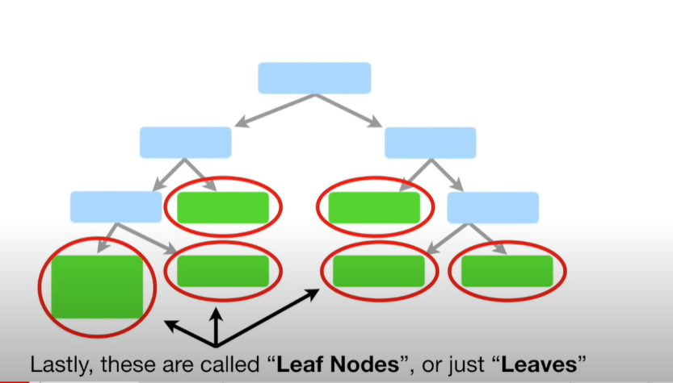

Slide 30
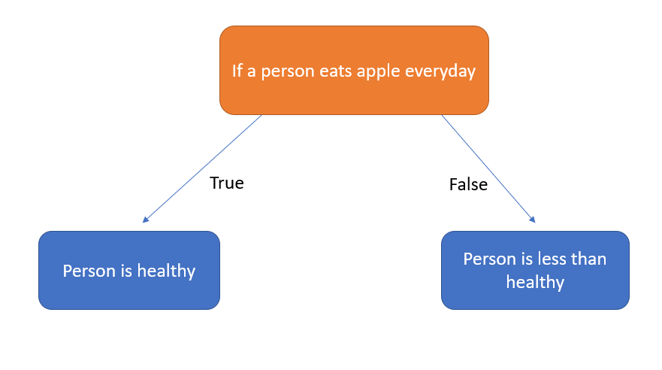

Slide 31
